Slide 1
Classification and Enhancement of SAR Images using Machine Learning Techniques
Project Guide : Mrs. G. Dayalin Leena
Team Members
Kamali V 513319104015
Nisha R 513319104021
Ramya S 513319104030
Shofica L 513319104039

Slide 2
Abstract
Image Classification nowadays is used to narrow the gap between the computer vision and human vision so that the images can be recognized by machines in the same way as we humans do. It deals with assigning the appropriate class for the given image. Recent classification works on the objects present in satellite images are based on assembly processes, a mixture of one or more classification systems. For the precise image classification, a novel neural network based convolution method is proposed. A new spiking neural network (SNN) algorithm is also applied to increase the contrast and quality of the input image resulting in an enhanced output image.

Slide 3
Introduction
Machine learning algorithms have been applied in SAR image classiﬁcation studies.
A synthetic-aperture radar (SAR) is an imaging radar stationed on a moving airborne vehicle.
Like a typical radar, SAR transmits and receives electromagnetic waves sequentially and the corresponding echoes are collected.
Transmission and reception occur at successive intervals and hence are mapped to different positions.
This creates a virtual perception of an antenna that is much longer than the actual size of the antenna.
The distance travelled by the aircraft in simulation of this antenna is known as synthetic aperture.
In machine learning, most of the work is to choose the correct set of features.
Since it is task speciﬁc, the designed features must well discriminate among different images.

Slide 4
Literature Survey
S. No | Title | Year | Author | Methodology | Journal
01. | SAR image classification based on spiking neural network through spike-time dependent plasticity and gradient descent | 2022 | Xiaolan Qiu | This article proposes a full-link method from the unsupervised learning of SNN based on STDP to the supervised learning of SNN based on gradient descent. | ISPRS
02. | Towards big SAR data era: An efficient Sentinel-1 Near-Real-Time In SAR processing workflow with an emphasis on co-registration and phase unwrapping. | 2022 | Zhangfeng Ma | This article proposed workflow explores two key steps in Sentinel-1 NRT processing: Big SAR data co-registration and 3D phase unwrapping. | ISPRS
03. | Unsupervised learning method for SAR image classification based on spiking neural network | 2021 | Jiankun Chen | This paper proved that the synaptic weight in SNN could be dynamically updated by STDP rule without any supervision. | IEEE

Slide 5
S. No | Title | Year | Author | Methodology | Journal
04. | Hybrid inference network for few-shot SAR automatic target recognitions. | 2021 | Li Wang | This paper propose SAR target recognition using few-shot . The automated target recognition is applied to hybrid inference network and experimentally verification is carried out on the MSTAR dataset. | IEEE
05. | Complex Contourlet-CNN for polarimetric SAR image classification | 2020 | Lingling Li | This article propose a complex multiscale network named complex Contourlet-CNN is proposed for PolSAR image classification task | ISPRS
06. | Region level SAR image classification using deep features and spatial constraints. | 2020 | Anjun Zhang | This paper propose a region-level SAR image classification using novel CNN algorithm. | ISPRS

Slide 6
Existing System
We came to know that Synthetic Aperture Radar(SAR) image classification method based on Convolution Neural Network(CNN) has faced some problems such as poor noise resistance and generalization ability.
By comparing noise resistance and model parameters between SNNs and CNNs, the effectiveness and outstanding advantages of SNN are verified.

Slide 7
Disadvantage of Existing System
Spiking neural networks are still a relatively new and developing area of research
The performance and efficiency may not yet be comparable to traditional neural networks for some applications.
The classification using spiking neural network is not accurate.
The accuracy of the system may be limited by the quality and quantity of the training data.

Slide 8
Proposed System
Efficient image classification.
Combines classical CNN method and advanced SNN method.
Fine tuned enhanced image.

Slide 9
Modules Split-Up
Preprocessing
Data set collection
Noise reduction
Classification (CNN)
Convolution Layer
Max Pooling
Activation Function (ReLu Layer)
Fully Connected Layer
Tuning (SNN)
Action potentials
Spikes
Pulses

Slide 10
Architecture Diagram
CNN
Input
Convolution
Pooling
Fully connected
Dataset
Output
SNN
Input Layer
Hidden Layer
Output Layer

Slide 11
Algorithms
Convolution Neural Network(CNN)
Convolution Neural Network (CNN) built-in convolutional layer reduces the high dimensionality of images without losing its information.
The main application of convolution neural network is image and speech recognition.
Spiking Neural Network(SNN)
Spiking Neural Network (SNN) is one of the core components of brain-like intelligence and has good application prospects.
It is well suited for functions such as data/pattern classification, estimation, prediction, signal processing and robotic control applications.

Slide 12
Dataflow diagram
INPUT
CNN MODEL
SNN MODEL
OUTPUT
CLASSIFY THE IMAGE
ENHANCE THE IMAGE

Slide 13
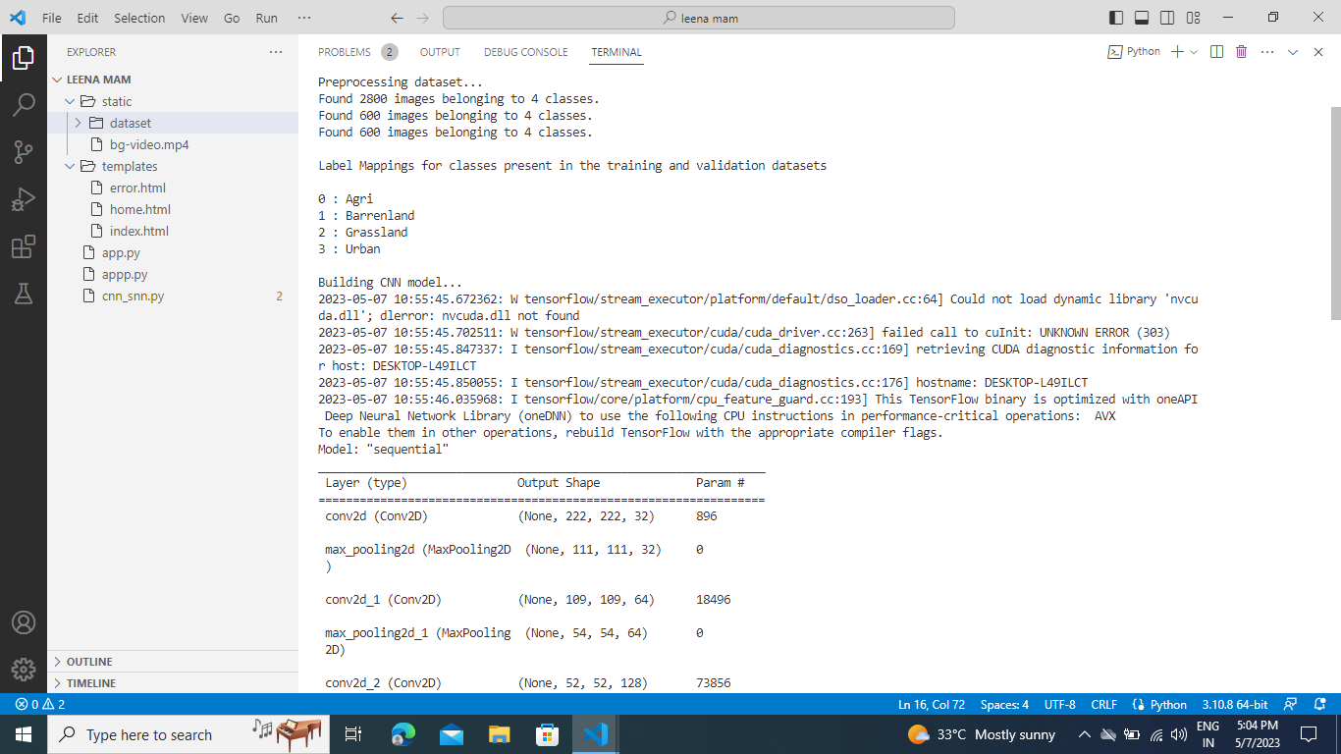
BACKEND DESIGN OUTPUT

Slide 14
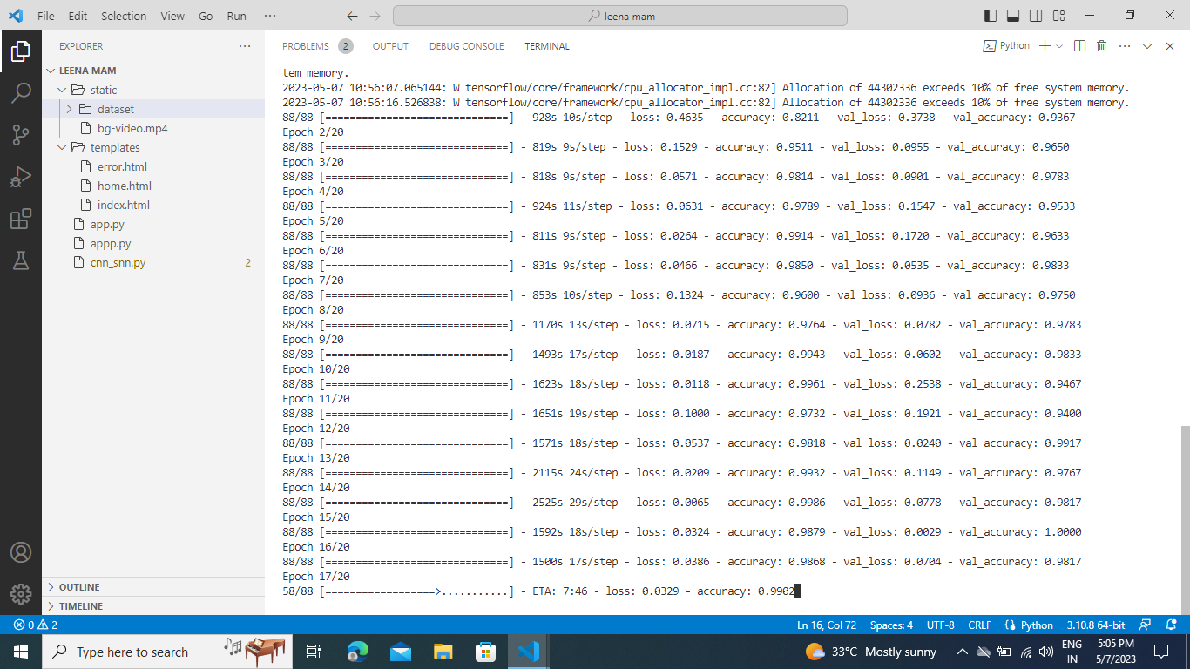

Slide 15
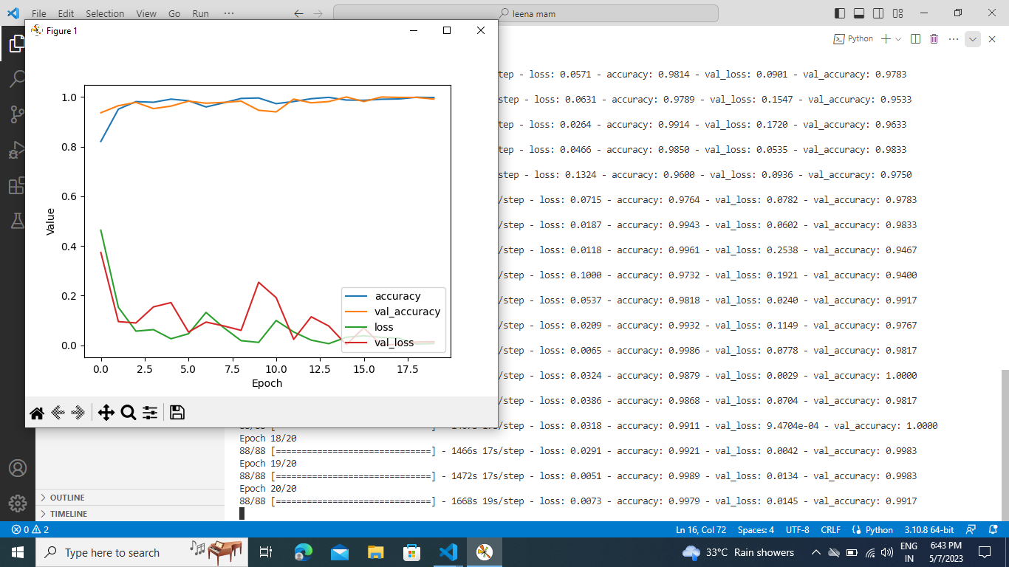

Slide 16
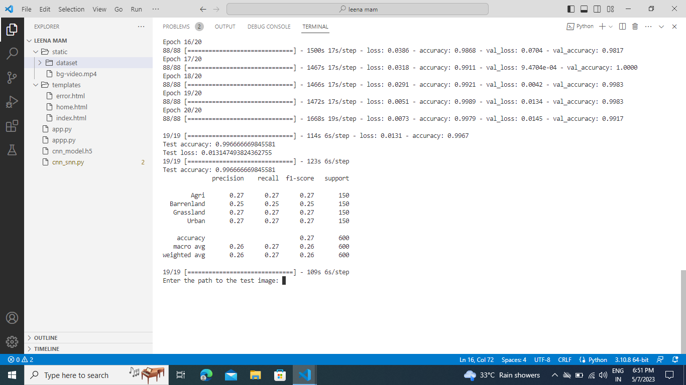

Slide 17

FRONTEND DESIGN OUTPUT

Slide 18
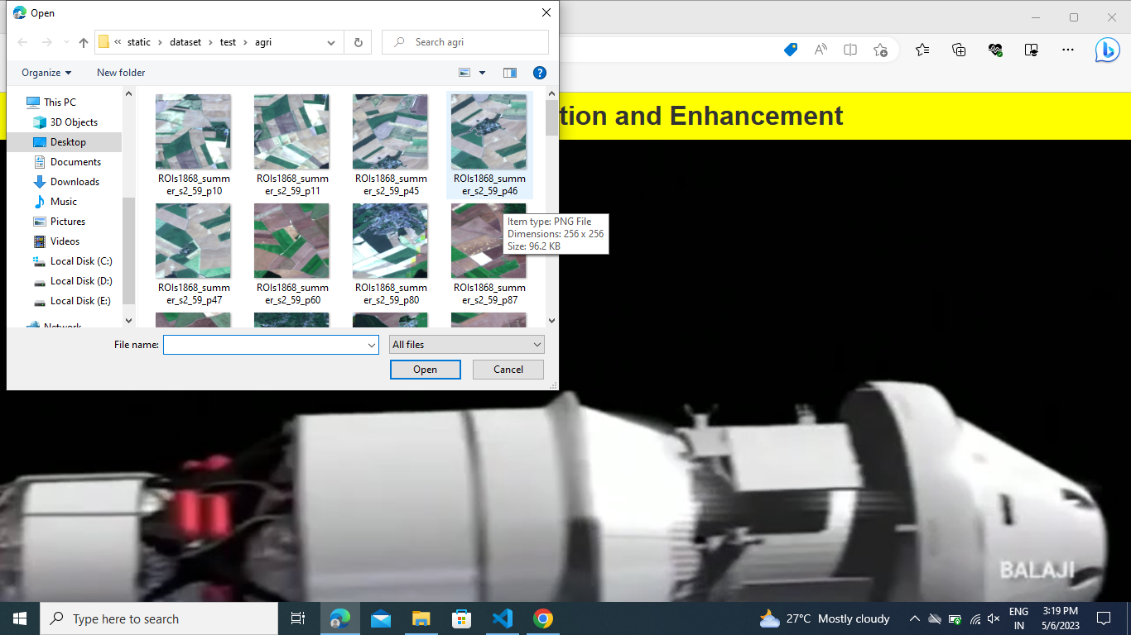

Slide 19
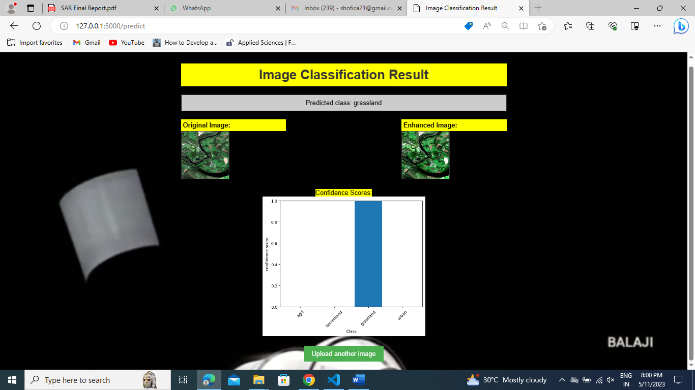

Slide 20
CONCLUSION
Explored machine learning techniques for SAR image classification and enhancement.
Preprocessing involved noise reduction and speckle filtering.
Utilized convolutional neural networks (CNN) for image classification.
Applied a spiking neural network (SNN) for image enhancement.
Results demonstrated effectiveness in both classification and enhancement.
CNN achieved high accuracy in image classification.
SNN significantly improved image quality by reducing noise and enhancing details.

Slide 21
References
[1] | W. Mcculloch, W. Pitts, A logical calculus of the ideas immanent in nervous activity, The bulletin of mathematical biophysics 5 (4) (1943) 115–133. doi:10.1007/BF02478259.
[2] | Alberto, M.; Prats- Iraola, P.; Younis, M.; Krieger, G.; Hajnsek, I.; Papathanassiou, K.P. A tutorial on synthetic aperture radar. IEEE Geosci. Remote Sens. Mag. 2013, 1, 6–43.
[3] | A. K. Engel, P. Konig, et al., Temporal coding in the visual cortex: new vistas on integration in the nervous system - ScienceDirect, Trends in Neurosciences 15 (6) (1992) 218–226. doi:10.1016/0166-2236(92)90039-B.
[4] | K. I. Mcanally, J. F. Stein, Auditory temporal coding in dyslexia, Proceedings of the Royal Society B: Biological Sciences 263 (1373) (1996) 961–965. doi:10.1098/rspb.1996.0142.
[5] | Simard, M.; De Grandi, G.; Thomson, K.P.; Benie, G.B. Analysis of speckle noise contribution on wavelet decomposition of SAR images. IEEE Trans. Geosci. Remote Sens. 1998, 36, 1953–1962

Slide 22
[6] | Melgani, F.; Melgani, S.B. A Markov random field approach to spatiotemporal contextual image classification. IEEE Trans. Geosci. Remote Sens. 2003, 41, 2478–2487.
[7] | D. E. Rumelhart, G. E. Hinton, R. J. Williams, Learning representations by back-propagating errors, Nature 323 (6088) (1988) 533–536. doi:10. 1038/323533a0.
[8] | Deng, H.; Clausi, D.A. Gaussian MRF rotation-invariant features for image classification. IEEE Trans. Pattern Anal. Mach. Intell. 2004, 26, 951–955.
[9] | A. K. Seth, Neural coding: Rate and time codes work together, Current Biology 25 (3) (2015) 110–113. doi:10.1016/j.cub.2014.12.043.
[10] | Olivier, C.; Haffner, P.; Vapnik, N.V. Support vector machines for histogram-based image classification. IEEE Trans. Neural. Netw. 1999, 10, 1055–1064.
[11] | McNairn, H.; Kross, A.; Lapen, D.; Caves, R. Shang. Early season monitoring of corn and soybeans with TerraSAR-X and RADARSAT-2. Int. J. Appl. Earth Obs. Geoinf. 2014, 28, 252–259.
[12] | Li, W.; Prasad, S.; Fowler, J.E. Hyperspectral Image Classification Using Gaussian Mixture Models and Markov Random Fields. IEEE Geosci. Remote Sens. Lett. 2014, 11, 153–157.

Slide 23
THANK YOU

